Slide 1
MIS Charter 2018
Ekram
Anik
Shakil
Akash
Team AI-BI

Slide 2
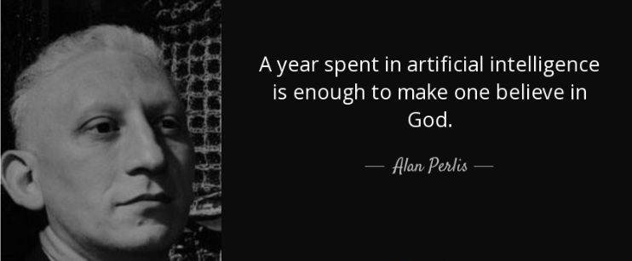

Slide 3


Slide 4
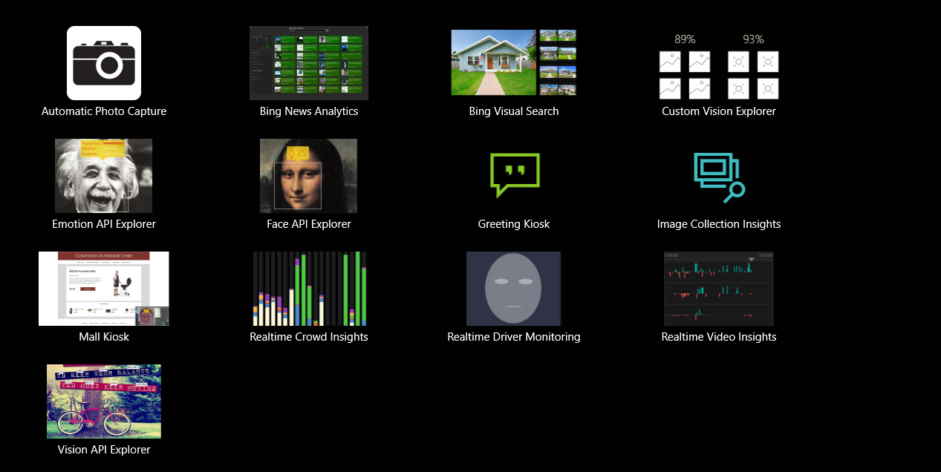

Slide 5
Achievements
BI Reporting Platform
Chat Bot
Social Media Analytics
FeedBack App for YAMAHA and Reporting for SHWAPNO
Churn Analysis & Prediction
Sales Forecasting
Prescription Management Software for Doctors
People Analytics
Rx Campaign
Version Controlling

Slide 6
Technologies
Web + BI Reporting Tool
AI, Machine Learning, Artificial Neural Network
Predictive Analytics
Mobile App
Desktop Application

Slide 7
Goals Next
Forecasting in Different fields (i.e. Inventory, Management, Procurement, Stock, Depot management)
Ensuring Scalable Application
Fault tolerant Storage
Distributed File System
Accelerating Reporting Module and Mobile App
System decouple to ensure unique storage entry point
Continuous Alignment with Technology Giants

Slide 8
And Technology
Complex Event Processing
Cloud
Streaming and Big Data Platform
AI, Machine learning

Slide 9
Purpose
Accelerating Business process
Enterprise data analytics
Strategic hybrid application to get valuable business insights
Load balancing large scale application

Slide 10


MOBILE BI
People are trying:
Tableau
Klipfolio
SAP BO

Slide 11
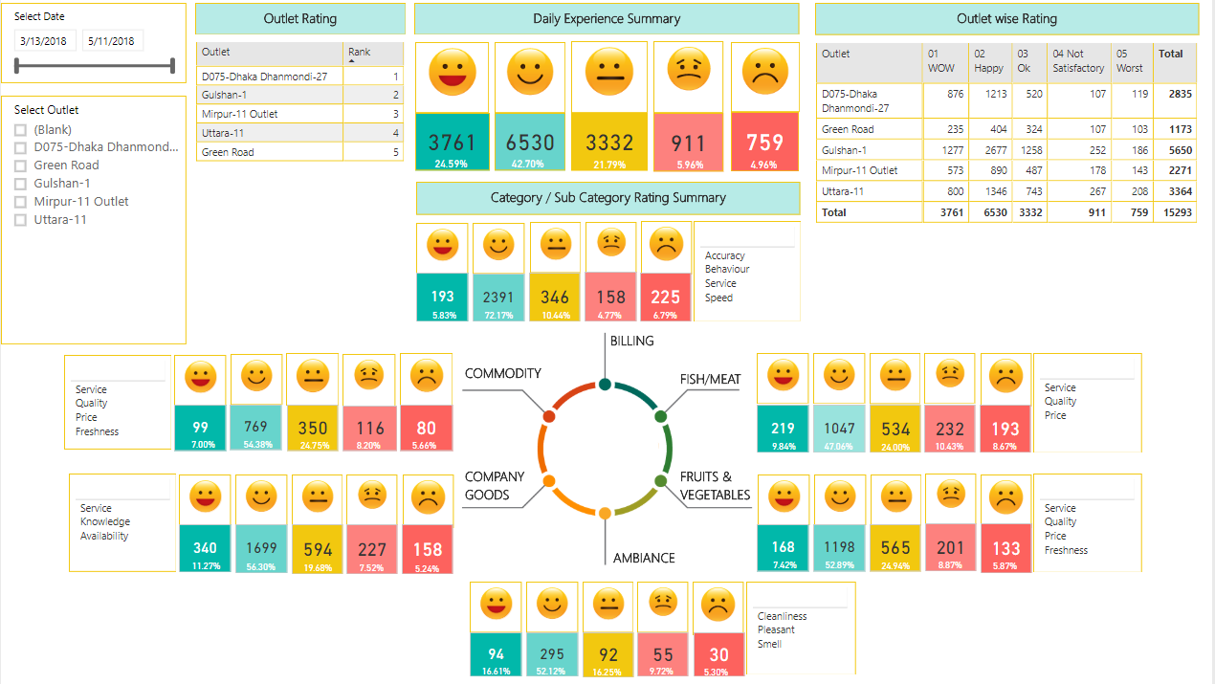
BI Reporting

Slide 12
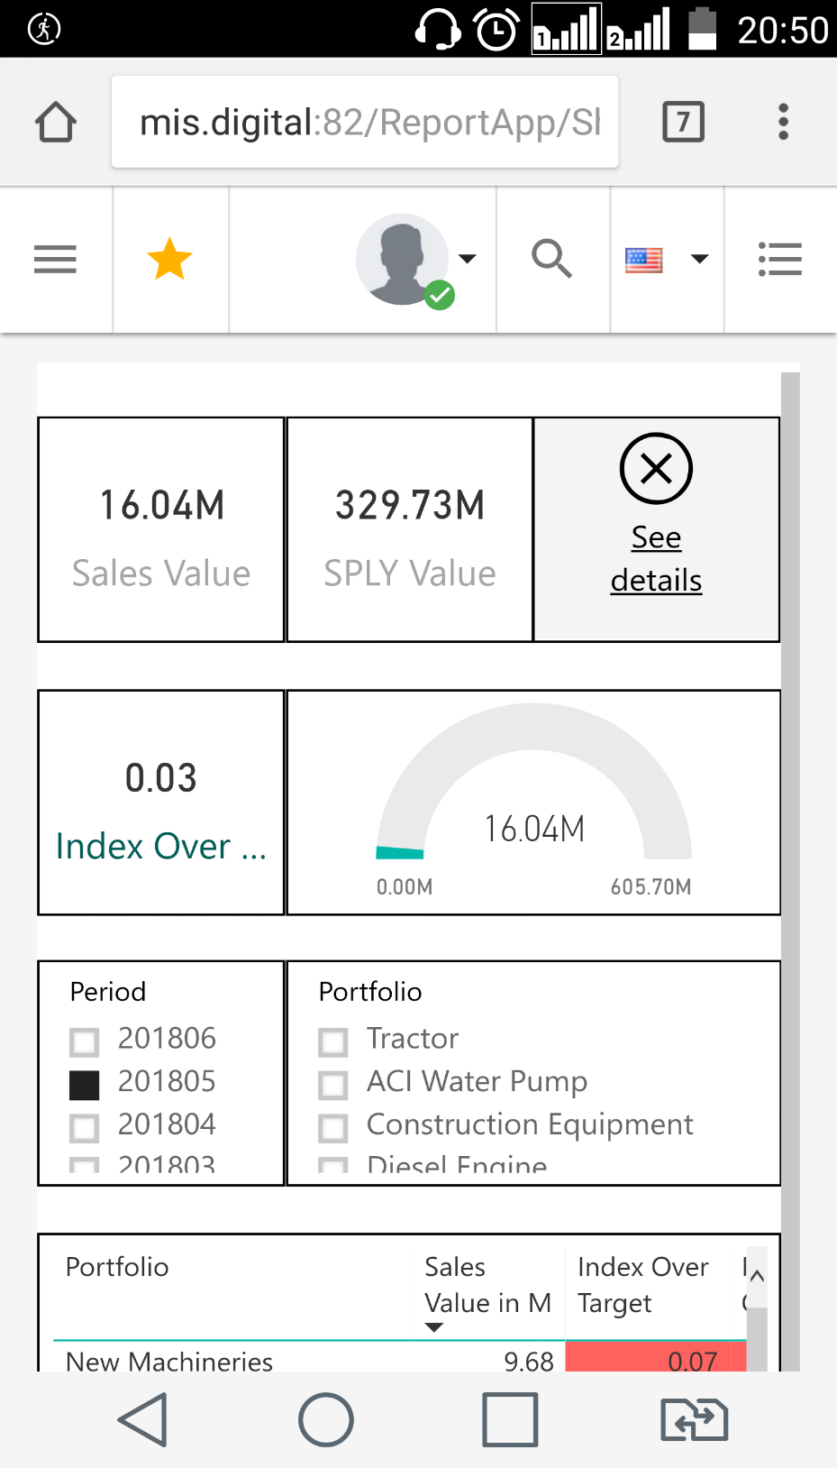
MOBILE BI by POWER BI

Slide 13
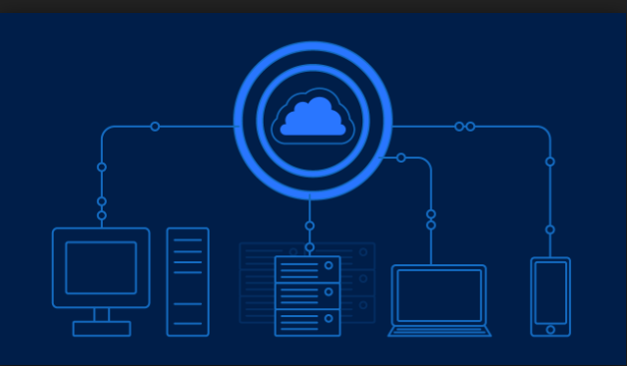
Distributed Computing

Slide 14
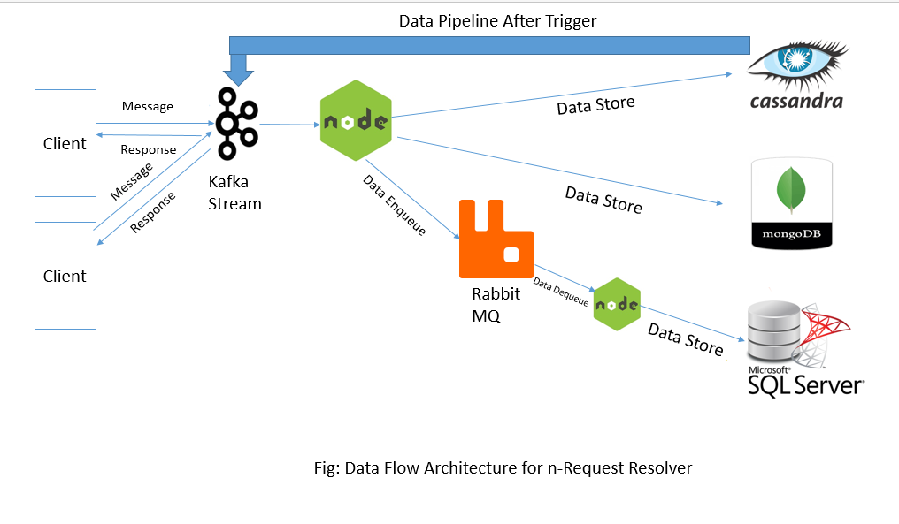
Architectural Overview of n-Req Handling

Slide 15

People Analytics for Organization

Slide 16

Behind Every Success…
Output
Behind the story

Slide 17

Welcome to AI-BI Team

